Slide 1
Deep Learning based License Plate Recognition
Monica Dommaraju
Jumana Zoeb Nadir
Sruthi Chilukuri

Slide 2
Introduction
License Plate Detection using
YOLOV3 (Darknet)
CNN
Trained models on Belgium Cars dataset.
Three main modules:
License Plate Detection
Characters Segmentation
Character Identification

Slide 3
Dataset
Approximately 700 Car images with multiple images for each car from different angles.
License plates for each of the cars with Image Augmentation.
ImageNet compatible annotations
Converted to YOLO supported labels
Additional test dataset from manually captured images.
Approx 1000 images for each character from 0 - 9 and A to Z
90% for train and 10% for test
Link

Slide 4
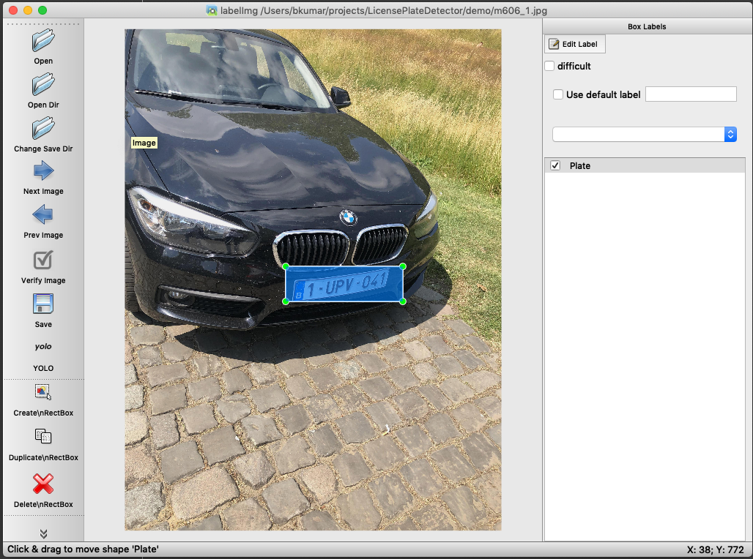
Annotations
Used LabelImg tool for generating
annotations.

Slide 5
Training - Darknet
Installed Darknet
Modified the yolo config files (classes, filter, steps, etc..).
Trained on GPU enabled EC2 box.
First model to detect License plate took 3 hrs (1 bounded box per car image)
Second model to Segment Characters and identify them took 8 hrs (Max 35 classes)

Slide 6
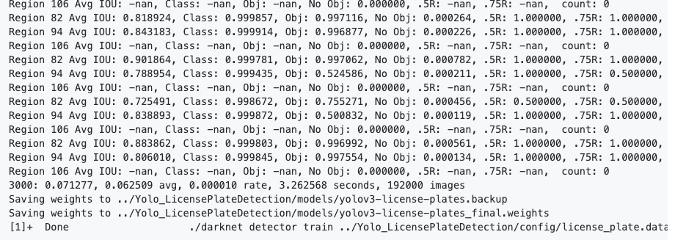
Training-Darknet
Results from final steps - License plate detection

Slide 7
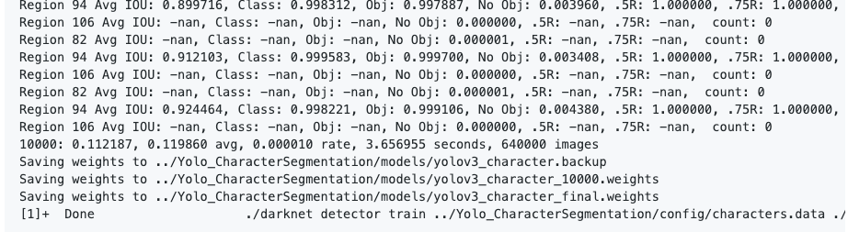
Training-Darknet
Results from final steps - - Character Segmentation and Identification

Slide 8
Transfer Learning
We have used the YoloV3 weights trained on ImageNet (darknet53.conv.74).
We used them as our network initial weights and trained the network.

Slide 9
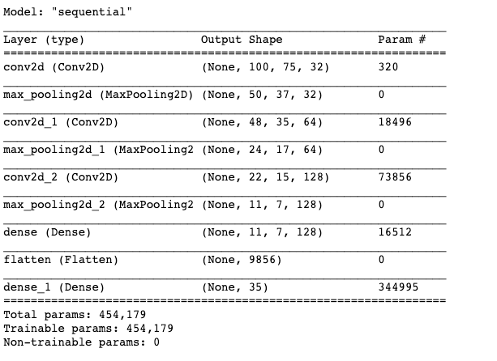
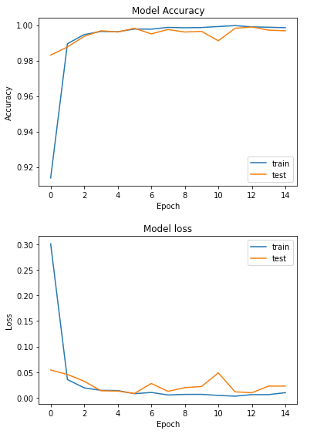
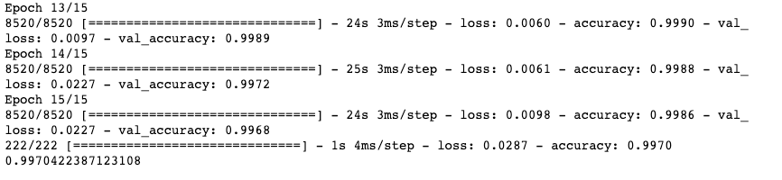
Training - CNN
99.7% Accuracy, 15 Epochs

Slide 10
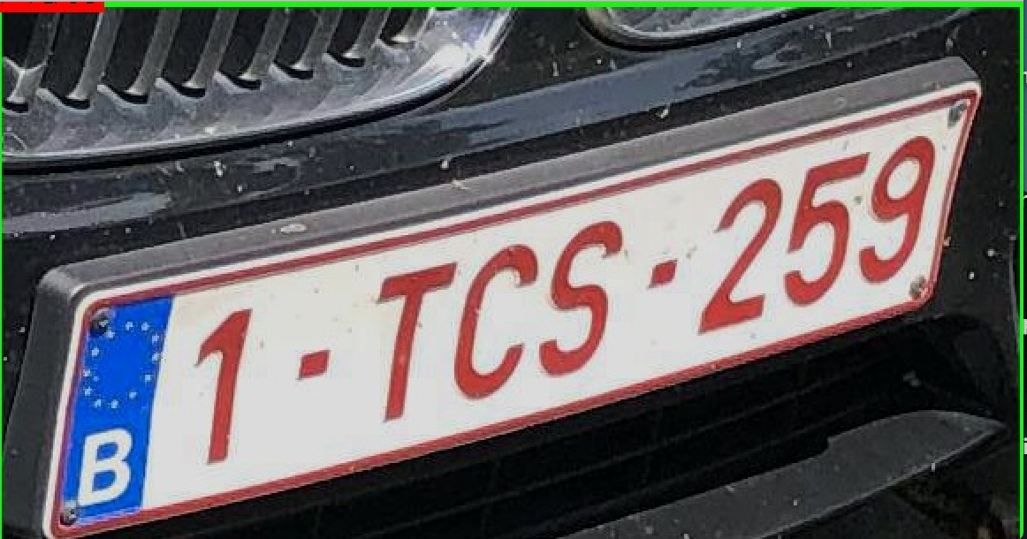
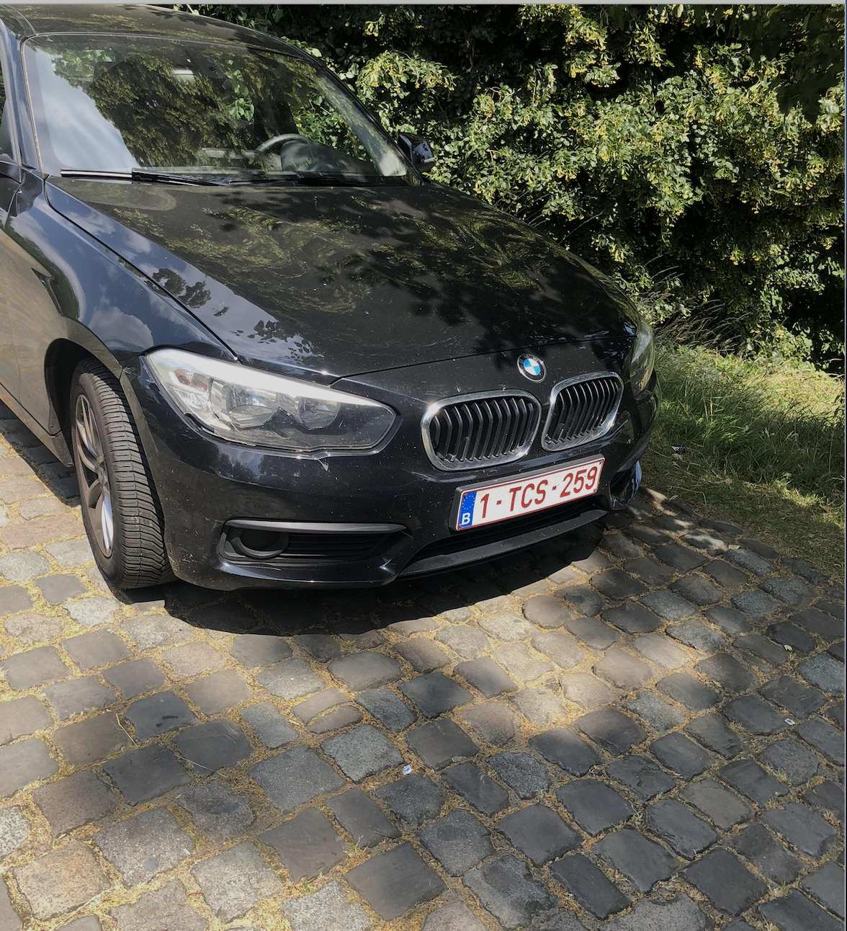
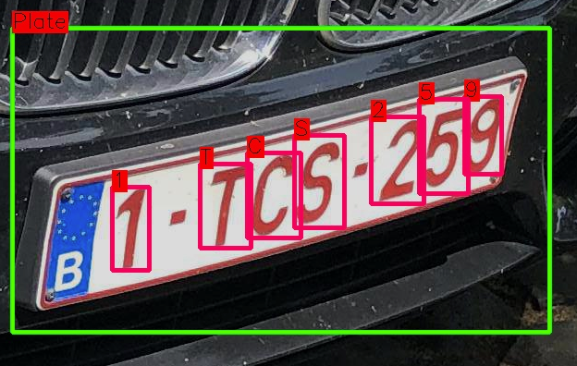
Prediction

Slide 11
Configurations
YOLOV3 + YOLOV3
License plate detection with one bounded box will be predicted using YOLO.
Characters Segmentation and identification also uses YOLO
YOLOV3 + CNN
License plate detection with one bounded box will be predicted using YOLO.
Segmentation of Characters in the bounded box is predicted using OpenCV contour image processing
Characters inside the segmented boxes are identified by trained CNN.

Slide 12
TFX- Airflow
Used TFX and Airflow to create a DAG pipeline.
CNN model training for character recognition was used in TFX
Darknet training cannot be performed on TFX, as the training requires compile C libraries and shell commands.

Slide 13
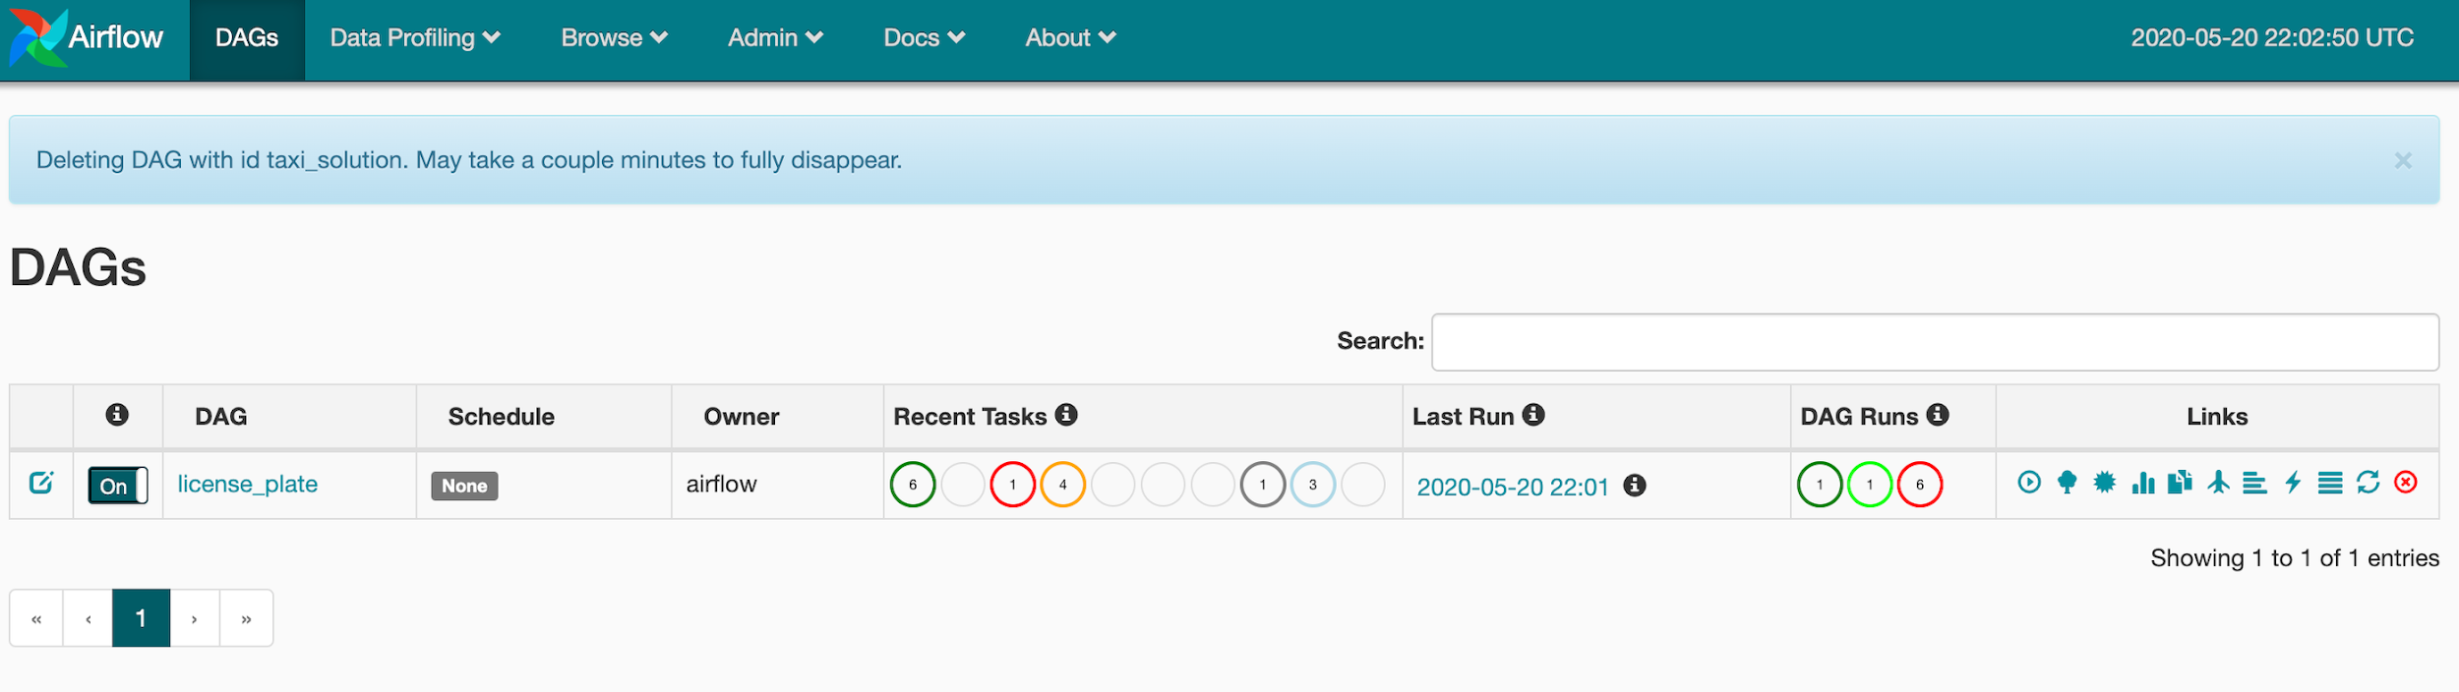
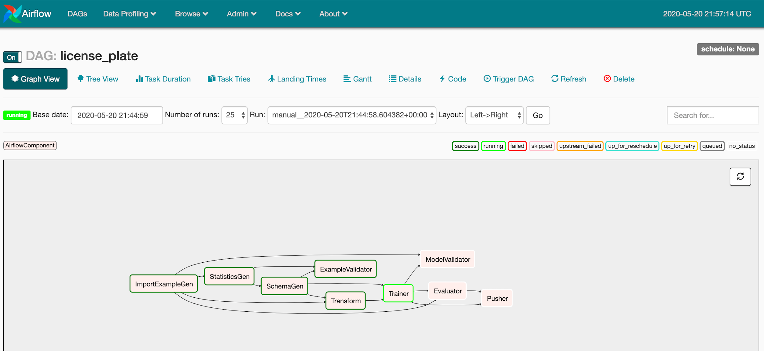
TFX - Airflow

Slide 14
Web Application
Used Python Flask to develop APIs and FrontEnd
Loaded Models and Weights that were generated in the training process.
Can predict License Registration Number on both Image and Video
Deployed the app to Amazon EC2

Slide 15
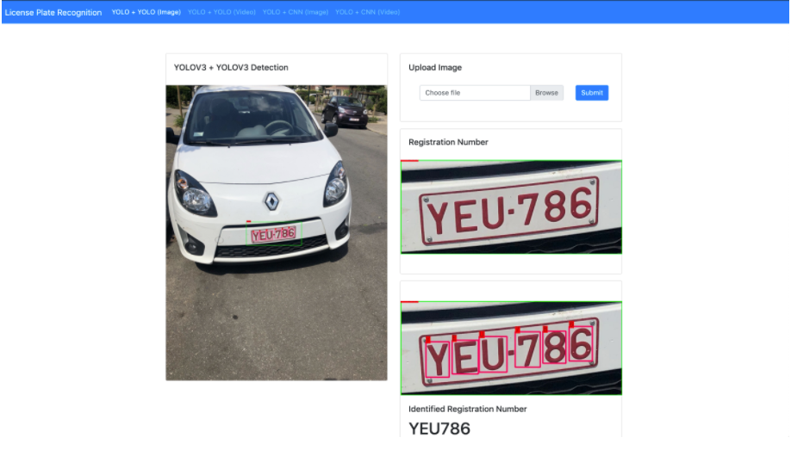
Web Application

Slide 16
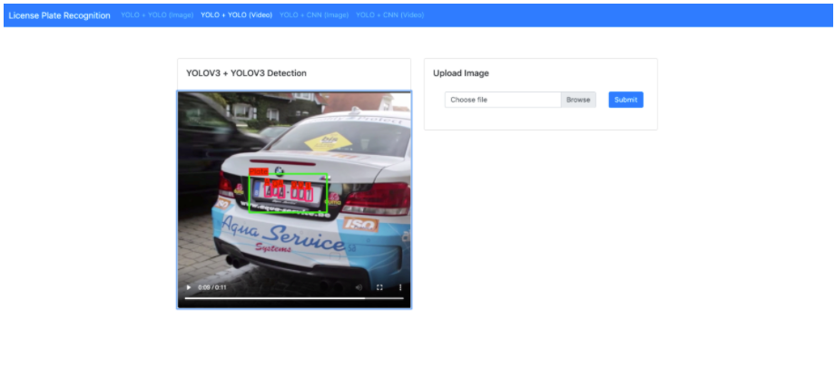
Web Application

Slide 17
DEMO

